Slide 1
For The Term Paper:
Pick a country and collect Macroeconomic data for that country (GDP, interest rates, consumption, investment, inflation, unemployment…)

Slide 2
You may pick any country that you want
Keep in mind that you need to collect macroeconomic data which might be more difficult from some countries
Pick a country that you are interested in or want to learn more about

Slide 3
Data-
Collect for a time period of 10-20 years
Present some or all of your data in the paper visually (in the form of graphs)

Slide 4
Data
You may need to construct certain data
For example: the real interest rate is equal to the nominal interest rate minus expected inflation

Slide 5
Where to find the data?
St. Louis Fed: https://fred.stlouisfed.org/
Central Banks
IMF
OECS
World Bank

Slide 6
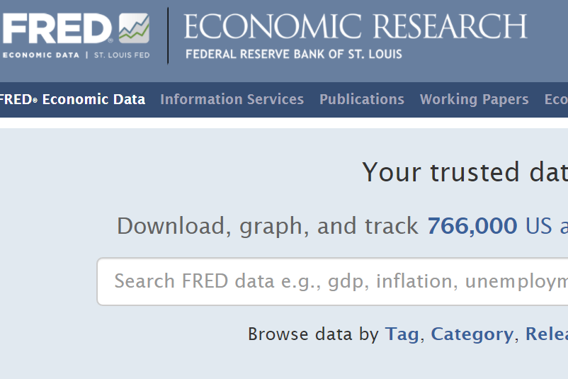

Slide 7
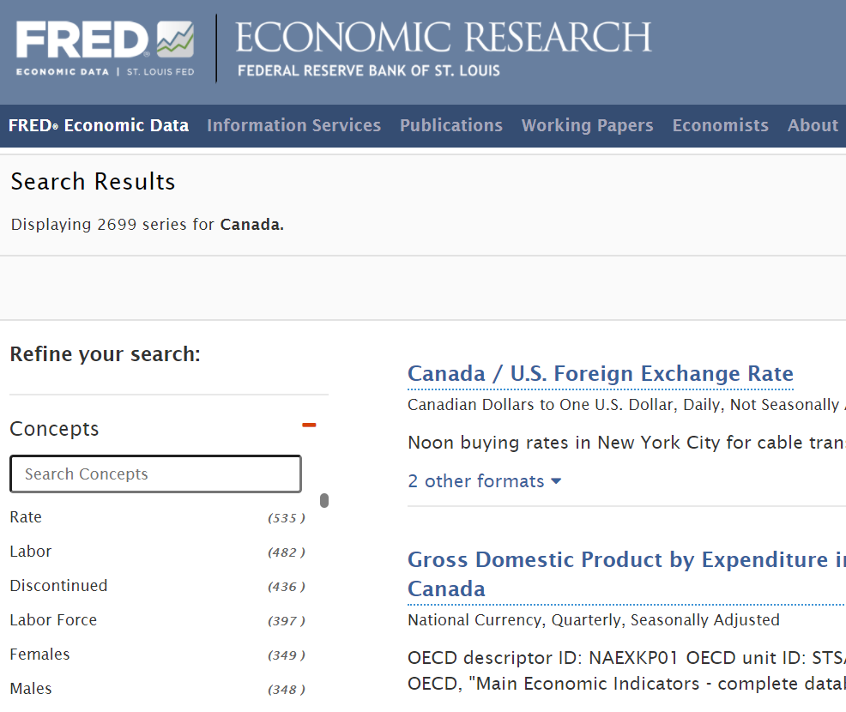

Slide 8
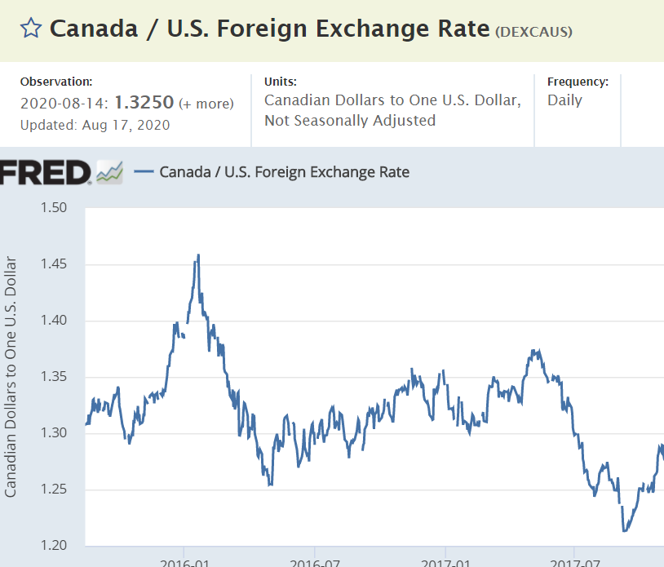

Slide 9
Paper outline
Introduction
Overview of country’s economy
Discussion of data collection
Macro topics (analyze some of the data using economic theory from class)
…
….
Conclusions

Slide 10
Macro topics (analyze some of the data using economic theory from class)
Use some of the models from class (loanable funds market, labor market,…) to explain any interesting movement in the data that you collected
You may choose which theories/markets that you want to discuss in your paper.

